Slide 1






.
Qt in Education
The
Model View
Framework
Notes:
This lecture introduces the model view framework. It shows views, available models, delegates, proxy models for sorting and filtering, as well as selection models.
(There is another lecture showing how to implement custom models)
Recommended reading before the lecture:
http://doc.trolltech.com/4.6/model-view-introduction.html
http://doc.trolltech.com/4.6/model-view-model.html
http://doc.trolltech.com/4.6/model-view-view.html
http://doc.trolltech.com/4.6/model-view-delegate.html
http://doc.trolltech.com/4.6/model-view-proxy-models.html

Slide 2


© 2011 Nokia Corporation and its Subsidiary(-ies).
The enclosed Qt Materials are provided under the Creative Commons
Attribution-Share Alike 2.5 License Agreement.
The full license text is available here:
http://creativecommons.org/licenses/by-sa/2.5/legalcode.
Nokia, Qt and the Nokia and Qt logos are the registered trademarks
of Nokia Corporation in Finland and other countries worldwide.

Slide 3
The Model View Controller Pattern
The MVC pattern aims
at separating
  the data (model)
  the visualization (view)
  modification (controller)
Provides clear responsibilities for all classes involved
Model
View
Controller
Notes:
The model-view-controller pattern is a so called design pattern. I.e., a recipe for how to divide a given problem into classes with different responsibilities
In an MVC implementation, the aim is to separate data from the visualization from the modification.
The model holds the data, the view visualizes the data and the controller modifies the contents of the model.
Continues

Slide 4
Why Model View Controller?
Separates the data from the visualization
  Avoids data duplication
  Can show the same data in multiple views
  Can use the same view for multiple data
Separates the visualization from the modification
  Can use application specific actions when altering data
  The view only needs a single interface for all editing
Notes:
Why would you want to use the mvc pattern?
One factor is that you do not have to duplicate data. For a large data set, this can be a substantial factor.
You can also visualize your model in multiple views. These views can be different – i.e. a table of data and a diagram visualizing the data.
You can also reuse views, i.e. that diagram visualizer, for different sources of data.
Focussing on the controller, this allows the usage of application specific modification routines in generic views
It also simplifies the views, as they can use a single interface for all controllers
Continues

Slide 5
Qt's Model View Concept
Qt's Model-View classes are implemented in the Interview framework
  Model and view
  Delegate responsible for editing an item for visualization
  Selection model
  synchronizes selections
  between multiple views
Model
Delegate
Selection
Model
View
Notes:
Qt's model-view implementation is different from the classical mvc, but works in much the same way
The model and view classes are present, but the controller is now called a delegate. The delegate takes a bigger responsibility than the controller, as it helps the view when visualizing as well.
In addition to these classes, there is a selection model. This model helps synchronizing selections between multiple views of the same model

Slide 6
The Model
The abstract model interface class QAbstractItemModel supports
  Lists – items in one column, multiple rows
  Tables – items in multiple rows and columns
  Trees – nested tables
Notes:
In Qt, the model is represented by the interface class QAbstractItemModel
The interface can expose:
lists, i.e. a column of items
tables, i.e. multiple columns or items
trees, which are implemented as nested tables, i.e. tables which can contain other tables in turn
This might seem obscure, especially the tree part, but we will look at it in detail soon.
Continues

Slide 7
List models
items
rowCount
List models consist of a range of items in a single row
Each item is addressed by a QModelIndex
Notes:
A list model consists of a single column of items.
The property rowCount reflects the number of items available
Each item can be addressed by a QModelIndex object
Continues

Slide 8
Table models
columnCount
rowCount
A table model places the items in a grid of columns and rows
Notes:
Expanding on this, the table adds the columnCount property
Each item is still represented by a QModelIndex
Notice, each cell is an item, so there are 12 items in the illustration.
Continues

Slide 9
Tree models
parent
columnCount
rowCount
child
A tree model is a table with child tables
Each sub-table has a QModelIndex as parent
The top level root has an invalid QModelIndex as parent
Only items of the first column can be parents
Notes:
Making the leap from table to tree adds another dimension to the model
First column items can have children, and each such child item has a parent
Each item is still represented by a QModelIndex, where the root parent, i.e. the parent of the top level item, is an invalid QModelIndex (i.e. the QModelIndex::isValid method returns false)
Notice that each sub-table can be of any dimension.
Technically, it is also possible for non-first column items to have parents – the limitation is a convention.
The end result is a very flexible interface to model data, making it possible to expose most sets of data
Continues

Slide 10
Data roles
Each model has a data method used for reading
The second argument, role, defaults to Qt::DisplayRole, but there are more roles
  DecorationRole – for icons, pixmaps, colors, etc
  EditRole – the data in an editable format
  FontRole – the font used by the default renderer
  CheckStateRole – the role to hold the items check state
  etc
QVariant QAbstractItemModel::data(
const QModelIndex &index, int role) const
Notes:
Each model has a data method for reading data for a given QModelIndex, i.e. a given item.
The method takes a second argument called role. This means that by using different roles, a single item can expose many types of data.
The most common roles are
DisplayRole, the text you see
DecorationRole, pixmaps, icons, colors
EditRole, the “value” of the item in an editable format
FontRole, the font to use when rendering
CheckStateRole, is the item checked or not
etc
Continues

Slide 11
The QModelIndex
The model index is used to address individual items of a model
QAbstractItem model provides the following useful methods
  index(row, column, parent=QModelIndex())
  rowCount(parent=QModelIndex())
  columnCount(parent=QModelIndex())
  parent(index)
The QModelIndex provides convenient methods
  data(role)
  child(row, column)
  parent()
Notes:
Each item of a given model can be addressed by a QModelIndex object
The QModelIndex class offers a easy-to-access data method, and knows of its parent model.
You get access to model indexes by asking the model.
As an invalid QModelIndex is the parent of the root level, and most methods default the parent to an invalid index, it is dead easy
index – gives you a model index for a given row/column/parent
rowCount/columnCount – gives you the model dimension for a given parent
QModelIndex::child gives you a QModelIndex for a child item of a given index, QModelIndex::parent provides a convenient access point to the parent
Continues

Slide 12
Available models
In addition to the abstract interface, Qt provides a set of ready to use models
  QStringListModel – a model exposing a QStringList through the model interface
  QFileSystemModel – a model exposing file system information (directories and files)
  QStandardItemModel – a model populated by QStandardItem objects. Can be used to create lists, tables or trees
Notes:
Qt does not only provide an abstract interface to models, there are a number or ready-to-use models available
The QStringList model makes it easy to build a simple list from a list of strings
The QFileSystemModel exposes files and directories from the file system through a model
This model is interesting, as it is lazy – i.e. it does not scan the full file system at once, but rather, only what is needed. We will look at how you do this later on
The QStandardItemModel lets you build lists, tables and trees from QStandardItem objects
Both the string list model and standard item model makes it impossible not to duplicate data, i.e. they take away one of the key points for MVC. However, they also make it possible to build models for testing and prototyping.

Slide 13
Available views
All views inherit the QAbstractItemView class
Four views are provided
  QListView
  QTableView
  QTreeView
  QColumnView
The QHeaderView widget is used to show headers for rows and columns
Notes:
Views implement the QAbstractItemView interface and are the widgets used to show the contents of a model.
Qt comes with four views – QListView, QTableView, QTreeView and QColumnView
Another view is the QHeaderView class, which is used by the other views to show headers for rows and columns
Continues

Slide 14
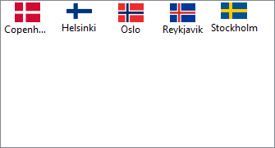
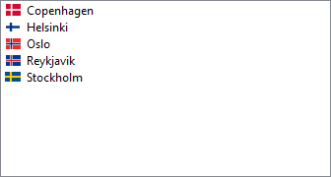
List view
Shows a single column
  Use the modelColumn property to select which column
Provides both IconMode and ListMode
Notes:
The list view shows a single column of a model. Each entry shown in the list corresponds to a row in the model.
By default, the first column is shown, but the modelColumn property can be used to select which column to show, so it is not necessary to show the first column of a table model just because you rely on a list view.
The view can be used in both icon mode and list mode as shown in the screenshots. The default mode is the list mode.
Continues

Slide 15
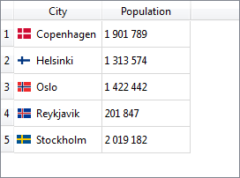
Table view
Shows a grid of items
Use hideRow and hideColumn to hide contents
  Show it again using showRow and showColumn
Notes:
The table view shows a grid of items in a table
By default, the entire model is shown, but using the hideRow and hideColumn methods, content can be hidden
Continues

Slide 16
Table View cont'd
Adapt the grid to the contents using resizeColumnsToContents and resizeRowsToContents
Access the headers using verticalHeader and horizontalHeader
  The stretchLastSection property lets the contents fill the width of the widget
  Headers can be hidden or shown
Control the scrollbars using the horizontalScrollBarPolicy and verticalScrollBarPolicy properties
Notes:
The methods resizeColumnsToContents and resizeRowsToContents can be used to adapt the size of the grid to the contents.
The headers are shown by the widgets returned by verticalHeader and horizontalHeader methods
These widgets can be hidden, if you for instance do not need a verticalHeader.
The property stretchLastSection lets the contents fill the full width of the table view widget, if there is space left over. This makes the view always fill the available screen area instead of restricting itself to the upper left corner.
The scrollbars of the view are controlled by the scroll bar policies. These methods are inherited by the view from the QAbstractScrollArea class. You can turn them on, off or let Qt do so when needed.
Continues

Slide 17
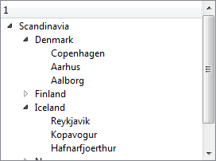
Tree view
Shown multi-column trees
Use setRowHidden and setColumnHidden to hide and show contents
Use expandAll, expandToDepth and collapseAll to control how much of the tree to show
Notes:
The tree view shows multi-column trees. This means that not only are the tree hierarchy shown, but for each row in the tree, the full column can be shown.
The setRowHidden and setColumnHidden methods can be used to hide contents.
The methods expandAll, expandToDepth and collapseAll let you control how much of the tree to show.
Continues

Slide 18
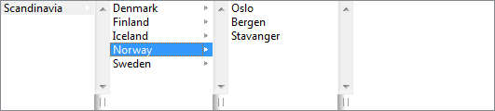
Column view
Shows a tree of lists in separate columns
Can hold a preview widget in the right-most compartment
Notes:
The column view shows a tree as a list of separate columns. It is not as common as the other models, but can be very effective when navigating certain sets of tree data.
It can also hold a preview widget in the right-most compartment. Here, the individual item can be shown in a way that makes sense in your application.
Continues

Slide 19
Mapping Data to Widgets
Using a QDataWidgetMapper, it is possible to map data from a model to widgets
QDataWidgetMapper *mapper = new QDataWidgetMapper;
mapper->setModel(model);
mapper->addMapping(cityEdit, 0);
mapper->addMapping(populationEdit, 1);
mapper->toFirst();
connect(nextButton, SIGNAL(clicked()), mapper, SLOT(toNext()));
connect(prevButton, SIGNAL(clicked()), mapper, SLOT(toPrevious()));
Notes:
Another view, per se, is the QDataWidgetMapper. It lets you map model data to widgets, thus providing a view.
The mapping usually maps a each column to a widget, showing a single row at a time. Using the orientation property, it is possible to show one column at a time, mapping each row to a widget.
It is then possible to set the a model index to control what data is shown. The slots toNext and toPrevious make it easy to implement a user interface that navigates in the model.

Slide 20
Widgets with Models
Sometimes separating the model from the view is too complex
  No data duplication takes place
  The model will have to process the data and duplicate it internally
For these scenarios, the QListWidget, QTableWidget and QTreeWidget exist
  Uses QListWidgetItem, QTableWidgetItem and QTreeWidgetItem respectively
Notes:
In some scenarios, separating the model from the view is just an over-engineered solution
Examples of this is where no actual (or very limited) data duplication takes place or when the model needs to process the data and thus duplicate it internally
For these scenarios, it can be good to use the QListWidget, QTableWidget and QTreeWidget classes.
They correspond to their view cousins, QListView, QTableView and QTreeView, but hold their models internally
The models are built from QListWidgetItem, QTableWidgetItem and QTreeWidgetItem objects respectively.

Slide 21
Break

Slide 22
The Delegate
The delegate is responsible for editing and item visualization
  The view uses and interacts with a delegate
  All delegates are derived from QAbstractItemDelegate
  By default, the
  QStyledItemDelegate
  is used.
Model
Delegate
Selection
Model
View
Notes:
Something that we have left out until now is the delegate class
The delegate is responsible for editing and visualizing individual items
All delegates implement the QAbstractItemDelegate interface
The default delegate, QStyledItemDelegate, is used by all views as a starting point. It offers a platform adjusted visualization for most data types.
Continues

Slide 23
Delegates and data types
The QStyledItemDelegate accepts the following
data types
The QItemEditorFactor
class determines which
widget to use for which
data type
Role | Types
CheckStateRole | Qt::CheckState
DecorationStyle | QIcon, QPixmap, QImage and QColor
DisplayRole | QString (QVariant::toString())
EditRole
Type | Widget
bool | QComboBox
double | QDoubleSpinBox
int / unsigned int | QSpinBox
QDate | QDateEdit
QDateTime | QDateTimeEdit
QPixmap | QLabel
QString | QLineEdit
QTime | QTimeEdit
Notes:
Looking at the default delegates, they handle most basic data types when it comes to visualizing
For editing, they rely on the QItemEditorFactory, which also supports the most basic types out of the box
This means that for most cases, you can rely on Qt's delegate and widgets to get a sensible editing experience for the user.
Continues

Slide 24
Custom delegates
Custom delegates can be implemented to handle painting and/or editing
  For custom editing but standard painting it is possible to sub-class QItemEditorCreatorBase
Delegates are assigned to an entire view, columns or rows of views
Notes:
It is possible, and quite common, to implement custom delegates.
This can be for two reasons:
to do custom painting
to do custom editing
If you only want to do custom editing, the QItemEditorCreatorBase is a good starting point. It lets you add a custom editor to the framework that the standard delegate relies on to create editors
When having implemented your custom delegate, you can then assign it to either an entire view, or to selected rows or columns of a view
Continues

Slide 25
Delegate for Painting
Painting depends on re-implementing the paint and sizeHint methods
class BarDelegate : public QStyledItemDelegate
{
Q_OBJECT
public:
explicit BarDelegate(int maxRange, QObject *parent = 0);
void paint(QPainter *painter,
const QStyleOptionViewItem &option,
const QModelIndex &index) const;
QSize sizeHint(const QStyleOptionViewItem &option,
const QModelIndex &index) const;
private:
int m_maxRange;
};
Notes:
In order to implement a custom painting delegate, the basic requirements are to implement the paint and sizeHint methods
The BarDelegate class declaration shown shows how these are declared, alongside a constructor.
Notice that the constructor also takes a maxRange, defining the maximum value that the bar is meant to represent.
Continues

Slide 26
Delegate for Painting
BarDelegate::BarDelegate(int maxRange, QObject *parent) :
QStyledItemDelegate(parent), m_maxRange(maxRange) { }
QSize BarDelegate::sizeHint(const QStyleOptionViewItem &option,
const QModelIndex &index) const
{
return QSize(100, 1);
}
Notes:
The implementation of the constructor can be considered trivial. m_maxRange is assigned.
The implementation of the sizeHint can also be considered trivial – it simply defines a minimum size
The interesting work is carried out in the paint method (on the next slide)
Continues

Slide 27
Delegate for Painting
void BarDelegate::paint(QPainter *painter,
const QStyleOptionViewItem &option, const QModelIndex &index) const
{
if(index.data().canConvert<int>())
{
QRect barRect = QRect(option.rect.topLeft(),
QSize(option.rect.width()*((qreal)index.data().toInt()/(qreal)m_maxRange),
option.rect.height()));
barRect.adjust(0, 2, 0, -2);
if(option.state & QStyle::State_Selected)
{
painter->fillRect(option.rect, option.palette.highlight());
painter->fillRect(barRect, option.palette.highlightedText());
}
else
painter->fillRect(barRect, option.palette.text());
}
else
QStyledItemDelegate::paint(painter, option, index);
}
Notes:
The paint method assumes that the data can be casted to an integer, otherwise the base class' implementation is invoked
If the value can be cast, the area of the bar is calculated and then painted. The colors used for painting depends on the state of the item (passed through option) and the palette (also passed through option).
Continues

Slide 28
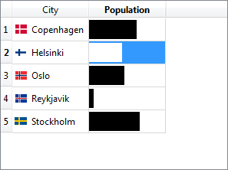
Using the Delegate
tableView->setModel(model);
tableView->setItemDelegateForColumn(1, new BarDelegate(3000000, this));
Notes:
In order to use the delegate, it needs to be assigned to a view.
The view then serves the model to the delegate, which in turn handles sizing and painting
In the example above, we set the item delegate for the second column (index 1)

Slide 29
Delegates for Editing
When editing, the view uses the delegate methods createEditor, setEditorData, setModelData and updateEditorGeometry
It is common practice to rely on the EditRole and not the DisplayRole for editor data
class BarDelegate : public QStyledItemDelegate
{
Q_OBJECT
public:
...
QWidget *createEditor(QWidget *parent, const QStyleOptionViewItem &option,
const QModelIndex &index ) const;
void setEditorData(QWidget *editor, const QModelIndex &index) const;
void updateEditorGeometry(QWidget *editor, const QStyleOptionViewItem &option,
const QModelIndex &index) const;
void setModelData(QWidget *editor, QAbstractItemModel *model,
const QModelIndex &index) const;
...
Notes:
When adding editing capabilities to a delegate, the methods createEditor, setEditorData and setModelData must be re-implemented
The methods cooperate so that createEditor creates an editing widget
The updateEditorGeometry is then invoked to set the geometry (location and size) of the editor widget
The setEditorData method is then used to update the contents of the editing widget with data from the model
When the editing is done, the setModelData method is used to set the data of the model given the result of the editing widget
One important convention to notice is that the EditRole is used when getting and setting editing data from a model. Even though this might be identical to the DisplayRole, used when visualizing
Continues

Slide 30
Delegates for Editing
QWidget *BarDelegate::createEditor(QWidget *parent,
const QStyleOptionViewItem &option,
const QModelIndex &index ) const
{
QSlider *slider = new QSlider(parent);
slider->setRange(0, m_maxRange);
slider->setOrientation(Qt::Horizontal);
slider->setAutoFillBackground(true);
return slider;
}
void BarDelegate::updateEditorGeometry(QWidget *editor,
const QStyleOptionViewItem &option,
const QModelIndex &index) const
{
QSlider *slider = qobject_cast<QSlider*>(editor);
if(slider)
slider->setGeometry(option.rect);
}
Notes:
In this example, we have left out all the logic for handling non-integer values
In the createEditor method, we create a QSlider widget. Its properties are set up to suite the application, i.e. range and orientation.
We also set the auto fill background property to true, as the table view is seen through the slider otherwise.
In the updateEditorGeometry we simply set the slider's geometry to match the item's, as given through the option.
Continues

Slide 31
Delegates for Editing
void BarDelegate::setEditorData(QWidget *editor, const QModelIndex &index) const
{
QSlider *slider = qobject_cast<QSlider*>(editor);
if(slider)
slider->setValue(index.data(Qt::EditRole).toInt());
}
void BarDelegate::setModelData(QWidget *editor, QAbstractItemModel *model,
const QModelIndex &index) const
{
QSlider *slider = qobject_cast<QSlider*>(editor);
if(slider)
model->setData(index, slider->value(), Qt::EditRole);
}
Notes:
The setEditorData and setModelData methods serve as the interface between the model and the editing widget
In setEditorData, data is taken from the model and set in the editor
In the setModelData, data is taken from the editor and set in the model
Notice that the Qt::EditRole is used and not Qt::DisplayRole. This is the established convention, as it is sometimes good to display data differently than when it is edited (example: a string with a thousand separators v.s. actual integer values)
Continues

Slide 32
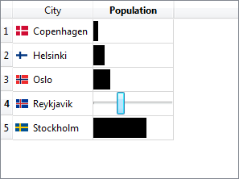
Using the Delegate
tableView->setModel(model);
tableView->setItemDelegateForColumn(1, new BarDelegate(3000000, this));
Notes:
Using the delegate is no different from when using it just for visualization.
This illustrates the fact that the model-view approach really separates view from data from editing. The same view and model are used, but the visualization and editing are custom written for this particular application.

Slide 33
Custom Data Roles
When working with delegates, it is useful to be able to pass more data between the model and delegate
It is possible to declare user roles
  Use Qt::UserRole as first value in enum
class CustomRoleModel : public QAbstractListModel
{
Q_OBJECT
public:
enum MyTypes { FooRole = Qt::UserRole, BarRole, BazRole };
...
Notes:
When working with delegates, the different data roles become more and more important. For instance, you have to relate to text, decoration, alignment and so on in your delegate implementation.
It is possible to move beyond the standard roles and define user roles. This lets you pass even more data between the model and the delegate. This way, you can provide additional data relevant to your application using a standard interface. The standard views can still use the same view, they simply ignore the custom roles.
The roles are usually enumerated using an enum. The Qt::UserRole enum value is the last value defined by Qt. By using it as the starting value in your custom enum defining your roles, you ensure that you do not overlap Qt's roles.

Slide 34
Sorting and filtering
It is possible to sort and filter models using a proxy model
The QAbstractProxyModel provides
  mapping between models
  mapping of selections
The QSortFilterProxyModel simplifies this by providing interfaces for filtering and sorting
  The dynamicSortFilter property controls whether the results are to be buffered or generated dynamically
Notes:
A common situation is to have a model, but in the wrong order, or with too much content.
Here you can use a proxy model which you place between the view and your actual model
Most proxy models are based on the QAbstractProxyModel
The proxy model can filter and sort model contents. The QSortFilterProxyModel simplifies this by providing functionality that suites most cases
The dynamicSortFilter property is used to control whether the results are calculated on-the-fly, i.e. dynamically, or are buffered. This is important from a performance and memory consumption standpoint
Continues

Slide 35
Sorting
If the sortingEnabled property is set, clicking the header sorts the contents
  Applies to QTableView and QTreeView
By using a QSortFilterProxyModel it is possible to sort on a given column and role
  sortRole – default DisplayRole
  sortCaseSensitivity
Notes:
The table and tree views can automatically sort on columns. Simple set the sortingEnabled property to true, and the user can click the headers to sort
By using the QSortFilterProxyModel, you can programmatically sort on any column and role.
You can also set the case sensitivity for the sorting
Continues

Slide 36
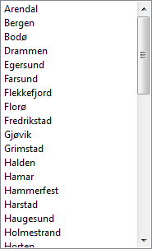
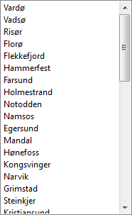
Sorting Example
QSortFilterProxyModel *sortingModel =
new QSortFilterProxyModel(this);
sortingModel->sort(0, Qt::AscendingOrder);
sortingModel->setDynamicSortFilter(true);
sortingModel->setSourceModel(model);
nonSortedView->setModel(model);
sortedView->setModel(sortingModel);
Notes:
In the example, the QSortFilterProxyModel is configured
The sort call tells it to sort the first column (index 0) in ascending order
We tell it to sort dynamically, as the list is small
And we set a source model
We then setup the two views with the model and the sortingModel
Continues

Slide 37
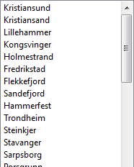
Custom Sorting
To implement a more complex sorting algorithm, sub-class and re-implement lessThan method
bool MySortProxyModel::lessThan(const QModelIndex &left,
const QModelIndex &right) const
{
if(left.data().toString().length() == right.data().toString().length())
return left.data().toString() < right.data().toString();
else
return (left.data().toString().length() < right.data().toString().length());
}
MySortProxyModel *customSortModel = new MySortProxyModel(this);
customSortModel->sort(0, Qt::DescendingOrder);
customSortModel->setDynamicSortFilter(true);
customSortModel->setSourceModel(model);
customSortedView->setModel(customSortModel);
Notes:
For more complex sorting cases, for instance when taking multiple roles into account, or where additional parsing of the data is required, you can re-implement the lessThan method
Simply sub-class the QSortFilterProxyModel and re-implement lessThan.
In the example, we sort on the length of the given strings, or their alphabetical order if the length is identical.
Using the models is just as easy as using any QSortFilterProxyModel.
Continues

Slide 38
Filtering
Filtering makes it possible to reduce the number of rows and columns of a model
  filterRegExp / filterWildcard / filterFixedString
  filterCaseSensitivity
  filterRole
  filterKeyColumn
Notes:
A task similar, but not identical, to sorting, is filtering
Again, the QSortFilterProxyModel provides methods for filtering on different columns and roles.
It is possible to use wild cards, regular expressions or simply fixed strings for filtering
Continues

Slide 39
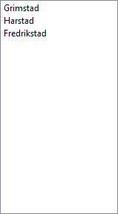
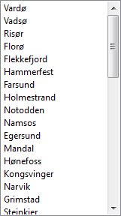
Filter Example
QSortFilterProxyModel *filteringModel =
new QSortFilterProxyModel(this);
filteringModel->setFilterWildcard("*stad*");
filteringModel->setFilterKeyColumn(0);
filteringModel->setDynamicSortFilter(true);
filteringModel->setSourceModel(model);
nonFilteredView->setModel(model);
filteredView->setModel(filteringModel);
Notes:
In the example here, we setup a QSortFilterProxyModel to filter using a wild card expression
The expression lets all entries containing the sub-string “stad” through
The filter is applied to the first column (index 0) and is applied dynamically
Continues

Slide 40
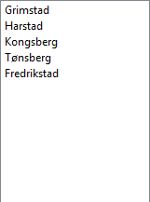
Custom Filtering
To implement more complex filters, sub-class and re-implement the filterAcceptRow and filterAcceptColumn methods
bool filterAcceptsRow(int sourceRow, const QModelIndex &sourceParent) const
{
const QModelIndex &index =
sourceModel()->index(sourceRow, filterKeyColumn(), sourceParent);
return index.data().toString().contains("berg") ||
index.data().toString().contains("stad");
}
MyFilterProxyModel *customFilterModel = new MyFilterProxyModel(this);
customFilterModel->setFilterKeyColumn(0);
customFilterModel->setDynamicSortFilter(true);
customFilterModel->setSourceModel(model);
customFilteredView->setModel(customFilterModel);
Notes:
Again, just as with sorting, it is possible to implement more complex solutions by sub-classing.
In the filter case, the interesting method is filterAcceptRow where items containing “stad” or “berg” are accepted.
Notice that the implementation takes the filter key column into account.
(This example could have been implemented using a regular expression and a QSortFilterProxyModel directly)

Slide 41
Working with Selections
Selections are handled by selection models
It is possible to tune a view to limit the selection
  Single items / rows / columns
  Single selection / contiguous / extended / multi / none
A selection model can be
shared between multiple views
Model
Delegate
Selection
Model
View
Notes:
When looking at Qt's model-view framework and comparing it to the classic MVC pattern, the selection model seems out-of-place. This is not the case.
The original MVC pattern fails to take item selections into account – or simply places them in the model. This can be managed by proxy models, but the Qt approach, with a separate selection model, gives a cleaner solution
As the selection model holds the selection status, you can share selections between views by sharing the selection model
The selection model is implemented by the QItemSelectionModel class
A selection can be limited to single items, rows or columns
It can also be limited to one selection, contiguous selections or extended selections (multi is just a variant of extended, and none is obvious)
Continues

Slide 42
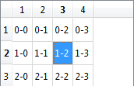
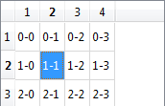
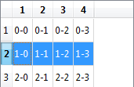
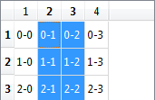
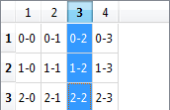
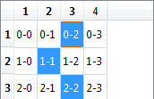
Selection Behavior and Modes
view->setSelectionBehavior(
QAbstractItemView::SelectItems);
view->setSelectionMode(
QAbstractItemView::SingleSelection);
view->setSelectionBehavior(
QAbstractItemView::SelectRows);
view->setSelectionMode(
QAbstractItemView::ContiguousSelection);
view->setSelectionBehavior(
QAbstractItemView::SelectColumns);
view->setSelectionMode(
QAbstractItemView::ExtendedSelection);
Notes:
The different selection modes are illustrated in the images above
SelectItems – individual items are selected
SelectRows – entire rows of items are selected
SelectColumns – entire columns of items as selected
SingleSelection – only one selection can be active at a time
ContiguousSelection – contiguous stretches of items can be selected
ExtendedSelection – any item(s) can be selected
MultiSelection is a version of ExtendedSelection, where the selected status of each item is toggled on clicks (a different feel to the user)
Continues

Slide 43
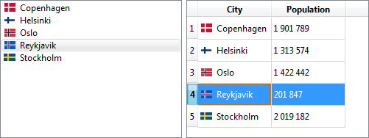
Sharing Selections
Sharing selections between views, combined with custom views can be a powerful tool
listView->setModel(model);
tableView->setModel(model);
listView->setSelectionModel(
tableView->selectionModel());
Notes:
Each view gets a unique selection model when constructed, but it is possible to explicitly set a selection model for a view
This makes it possible to share selections. Combine this with a custom view, and you can provide a detailed view of the current selection in no-time
Another example would be to expose the components of a CAD drawing through a model and share the selection between a tree view of the drawing and the actual visualization
Continues

Slide 44
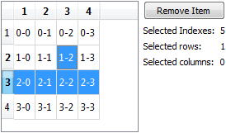
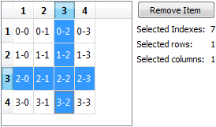
Reacting to Selection Changes
Connect to the selection model, not to the view
connect(view->selectionModel(), SIGNAL(selectionChanged(QItemSelection,QItemSelection)),
this, SLOT(updateSelectionStats()));
void Widget::updateSelectionStats()
{
indexesLabel->setText(QString::number(view->selectionModel()->selectedIndexes().count()));
rowsLabel->setText(QString::number(view->selectionModel()->selectedRows().count()));
columnsLabel->setText(QString::number(view->selectionModel()->selectedColumns().count()));
removeButton->setEnabled(view->selectionModel()->selectedIndexes().count() > 0);
}
Notes:
When monitoring selection changes, the trick is to know about the selection model
You connect to signals of the selection model, and not to the view. This way, you can react to selection changes
Monitoring the selectionChanged signal is usually enough. From there, you can query the selection model further
Notice how the selectedIndexes count the actual selected number of items, while selectedRows/Columns count the number of fully selected rows/columns

